Slide 1
41183 PRIVACY PRESERVING
Lecture 12. Subject Review

Slide 2
Assignment 2
Due on Friday, 11:59 pm, October 24, 2025
Individual work
You can use the previous topic, but NOT using Assignment 1 content
It is NOT allowed to using AI to complete your assignment
There is NO exam for this subject
Please complete the survey. Thanks.
Students can access the online survey at www.sfs.uts.edu.au via their mobile devices

Slide 3
Roadmap of the subject
Overview of privacy preserving
Access control and encryption for privacy
Anonymization and K-anonymity
Differential privacy I
Differential privacy II
Personalized privacy
Web browsing privacy
Deepfake attack and countermeasures
Federated learning and secure data aggregation
Poisoning attack and counter measures
Machine unlearning
Subject review

Slide 4
Week 2 outline
Background of access control
Authentication
Access control models
Threats to access control
Encryption for privacy protection

Slide 5
Week 3 Outline
Data anonymization background
Data anonymization method
K-anonymity
L -diversity
T-closeness

Slide 6
Week 4 Outline
Differential privacy background
Differentially privacy definitions
Differential privacy implementation
Differential privacy pros and cons

Slide 7
Week 5 Outline
Sensitive data collecting
Local differential privacy
Applications of differential privacy
Differential privacy for deep learning

Slide 8
Week 6 Outline
Background
Privacy measurement
Personalized privacy implementation

Slide 9
Week 7 Outline
Background
Web log, traffic analysis attack
https protocol for privacy
Packet Padding
Anonymous communication

Slide 10
Week 8 Outline
Deepfake background
Deepfake attacks
Deepfake countermeasures

Slide 11
Week 9 Outline
Federated learning background
Attacks on federated learning
Secure data aggregation

Slide 12
Week 10 Outline
Poisoning attacks background
Poisoning attacks techniques
Countermeasures against poisoning attacks

Slide 13
Week 11 Outline
Background of machine unlearning (MU)
Machine unlearning algorithms
Exact unlearning (fast retraining)
Approximate unlearning
Unlearning verification
Privacy and security issues in machine unlearning

Slide 14
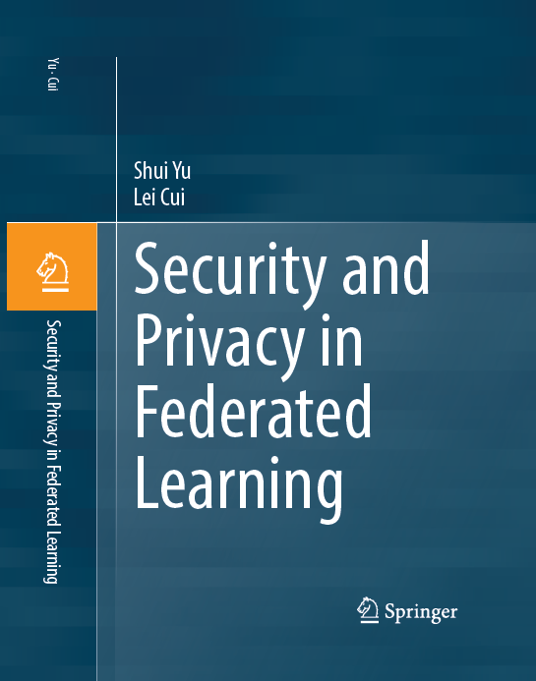
References
Other material will be
available at Canvas
Available at UTS library

Slide 15
The Topics we do not cover
Automatic driving
Semantic communication
Digital twin
Metaverse
Quantum computing
…

Slide 16

Thank you & Best wishes

